Slide 1





A practical introduction to programming Tenstorrent accelerators
Nick Brown
EPCC University of Edinburgh
Felix Le Clair
Tenstorrent
Jake Davies
EPCC University of Edinburgh

Slide 2
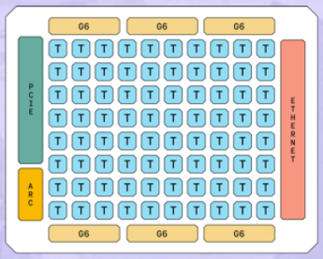
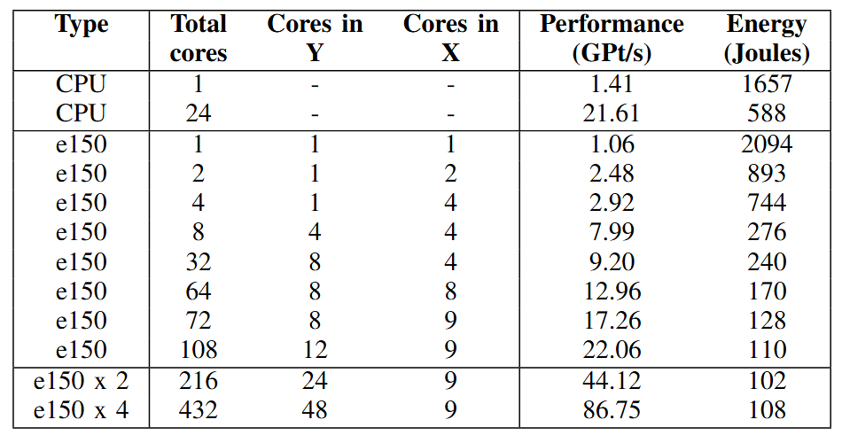
Motivation
There is increased focus on moving towards more energy efficient accelerator technologies in HPC whilst maintaining performance
Numerous accelerators for ML are being proposed, and some of these (such as Tenstorrent) are being made available for more general workloads
A lot of what you need in ML is also beneficial for HPC!
Tenstorrent decouples the movement of data from compute, potentially helping us with memory bound workloads
To the left is a stencil code on the Grayskull compared to a 24-core Xeon Platinum
Comparable performance, but five times less energy usage

Slide 3
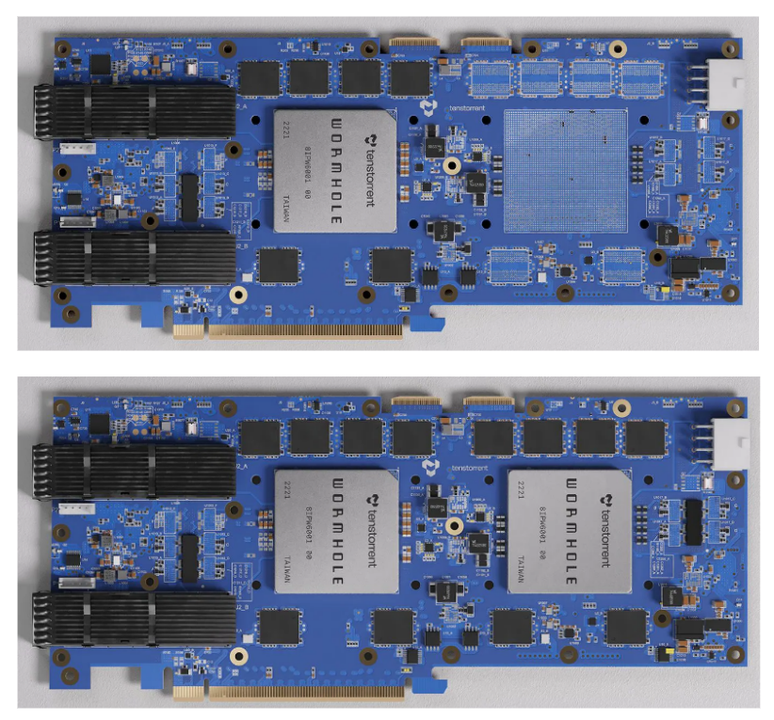
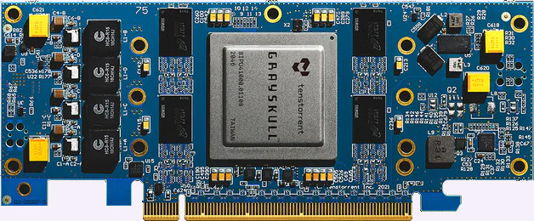
We focus on the Wormhole
The first generation was the Grayskull
This has been End Of Lived now
The current generation is the Wormhole
The next generation is the Blackhole
We have both Wormhole and Blackhole, using Wormhole today
All built using the Tensix architecture

Slide 4
Tutorial learning objectives
This tutorial is open to everybody, regardless of experience with HPC and accelerators
Is practically driven, where we will walk-through key concepts on the machine itself, and then you can explore the concepts more independently via a series of walk-throughs
Understand the Tenstorrent architecture & core concepts
We will explore the hardware, how it is designed the and key terminology
Get started with the Tenstorrent tt-metal SDK
Exploring key concepts for writing codes for the Tenstorrent architecture and understanding how to build these
Optimising codes on Tenstorrent by using the matrix engine and vector unit
Throughout we will be running on real Tenstorrent hardware
An awareness of RISC-V and how it underlies technologies such as this
We are also happy to discuss your own applications and how these might be ported to the architecture

Slide 5
Session plan
Time | Title | Type
14:00 – 14:05 | Introduction, welcome and objectives | Presentation
14:05 – 14:30 | An Overview of the Tenstorrent architecture | Presentation
14:30 – 14:40 | Logging onto the RISC-V testbed for Tenstorrent hardware | Practical
14:40 – 15:30 | Introduction to the SDK & data movement (lecture and two practicals) | Presentation and practicals
15:30 – 16:00 | Break
16:00 – 16:05 | Welcome back and overview of second part | Presentation
16:05 – 16:25 | Overview of compute SDK | Presentation
16:25 – 17:25 | Practicals three, four and five | Practicals
17:25 – 17:30 | Conclusions and audience next steps to continue working with the technologies | Presentation

Slide 6
Materials and the Tenstorrent community
We will remind people as we progress through the session
All materials for this tutorial are open source and can be found at
https://github.com/RISCVtestbed/tt-tutorial
More generally if you wish to continue exploring this after the tutorial finishes
https://docs.tenstorrent.com/
There is a Tenstorrent developer community
https://tenstorrent.com/developers
Discord at https://discord.com/invite/tenstorrent

